Slide 1
Time Series Unit 9
Model Identification and Parameter Estimation

Slide 2
Break Out 1

Slide 3
Texas Gas Prices

Slide 4
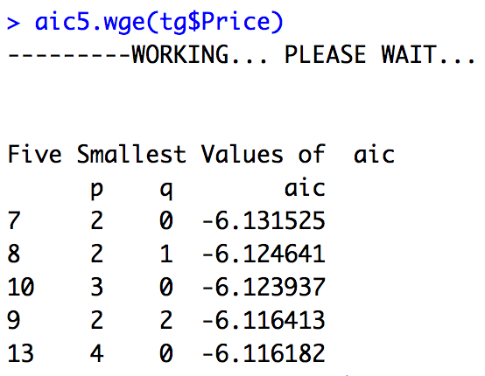
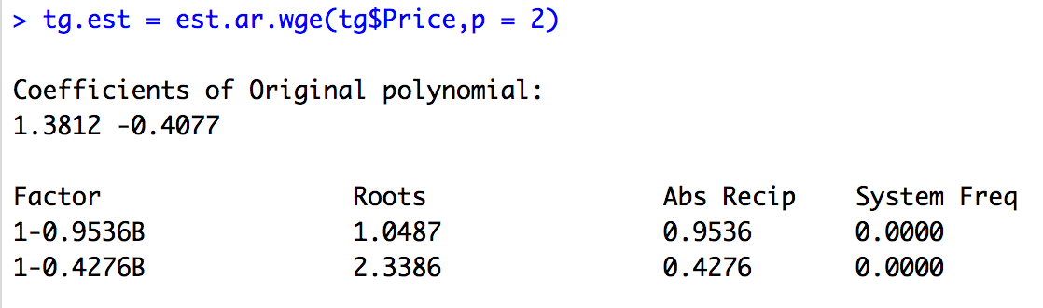
Texas Gas Prices: AR(2) With MLEs

Slide 5
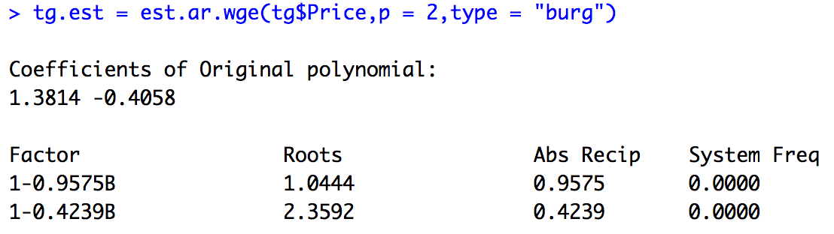
Texas Gas Prices: AR(2) With Burg

Slide 6
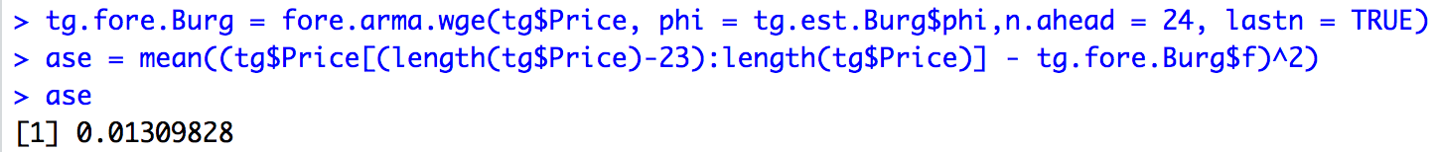
Texas Gas Prices: Forecasting with MLEs
tg.fore.Burg = fore.arma.wge(tg$Price, phi = tg.est.Burg$phi,n.ahead = 24, lastn = TRUE)
ase = mean((tg$Price[(length(tg$Price)-23):length(tg$Price)] - tg.fore.Burg$f)^2)
ase

Slide 7
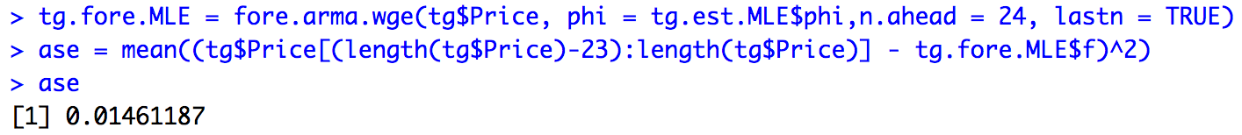
Texas Gas Prices: Forecasting with MLEs
tg.fore.MLE = fore.arma.wge(tg$Price, phi = tg.est.MLE$phi,n.ahead = 24, lastn = TRUE)
ase = mean((tg$Price[(length(tg$Price)-23):length(tg$Price)] - tg.fore.MLE$f)^2)
ase

Slide 8
Texas Gas Prices: Conclusion
MLE
Burg
While the ASE is slightly lower for the model with the Burg estimates, there does not seem to be a big difference between the two.

Slide 9
End Break Out 1

Slide 10
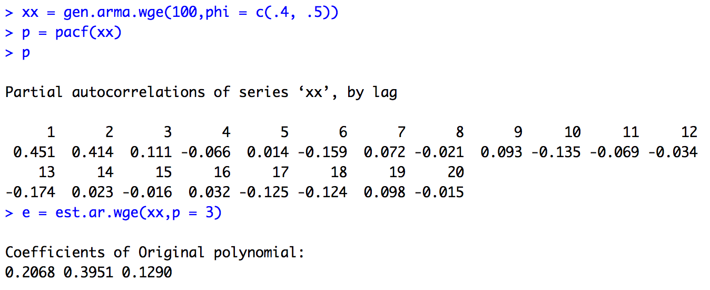
PACF Calculation Demo
xx = gen.arma.wge(100,phi = c(.4, .5))
p = pacf(xx)
p
e = est.ar.wge(xx,p = 3)
e = est.ar.wge(xx,p = 3,type = "yw")

Slide 11
Break Out 2
Use the Box-Jenkins model identification method (PACF) to identify the order of a model that best fits the data in the data set Unit9_2.csv.
Verify using est.arma.wge() the PACF values for lag = 1,2,3,4 and 5.

Slide 12
End Break Out 2

Slide 13
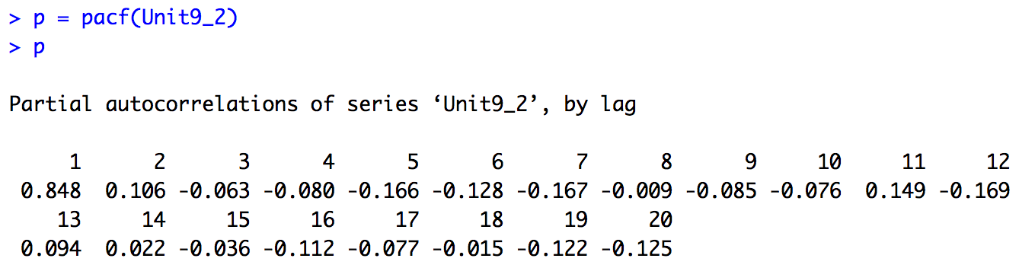
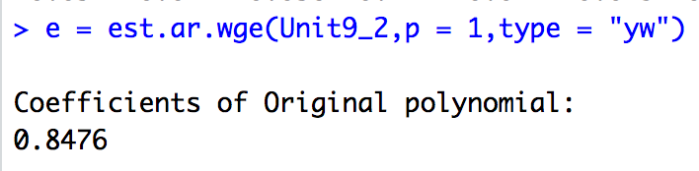
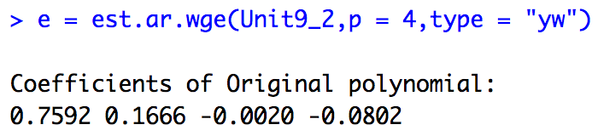
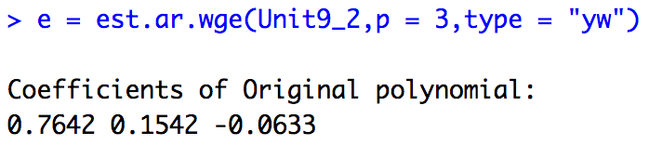
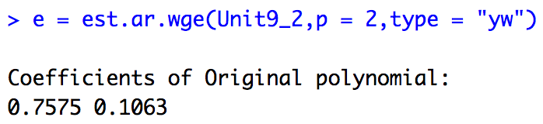
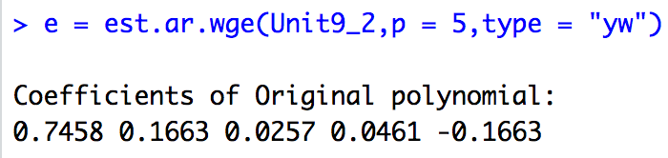
PACF
AR(1)

Slide 14
Break Out 3
Question from Asynch:
If you have roots close to 1, does this translate to wider confidence intervals to account for the instability? If so can you provide any additional insight?

Slide 15
End Break Out 3

Slide 16
Break Out 4

Slide 17
Identify and estimate a model that will be useful in forecasting the next 10 observations of the realization in the file: Unit9_1.csv.

Slide 18
End Break Out 4

Slide 19
Unit9_1

Slide 20
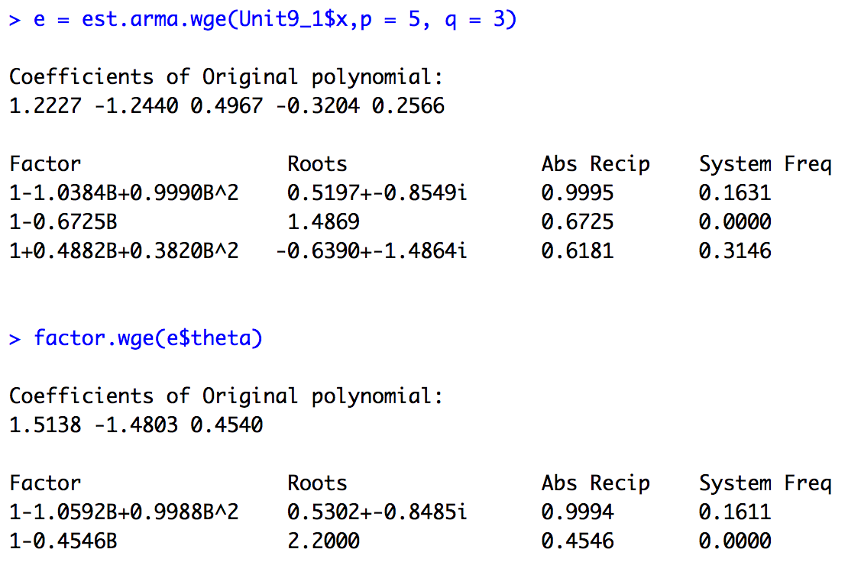
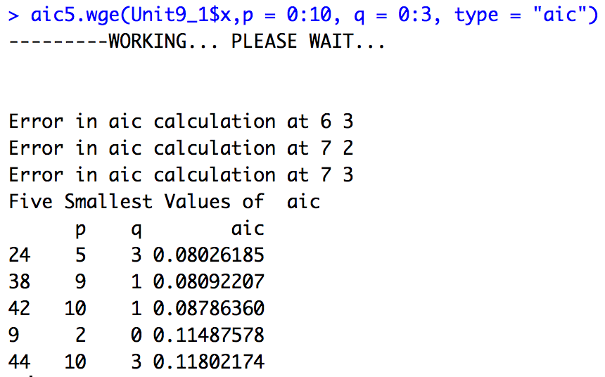
Unit9_1
The AR and MA factors with complex roots nearly cancel each other out leaving a 3 factors that have very little influence on the behavior of the realization (small Abs Recip).

Slide 21
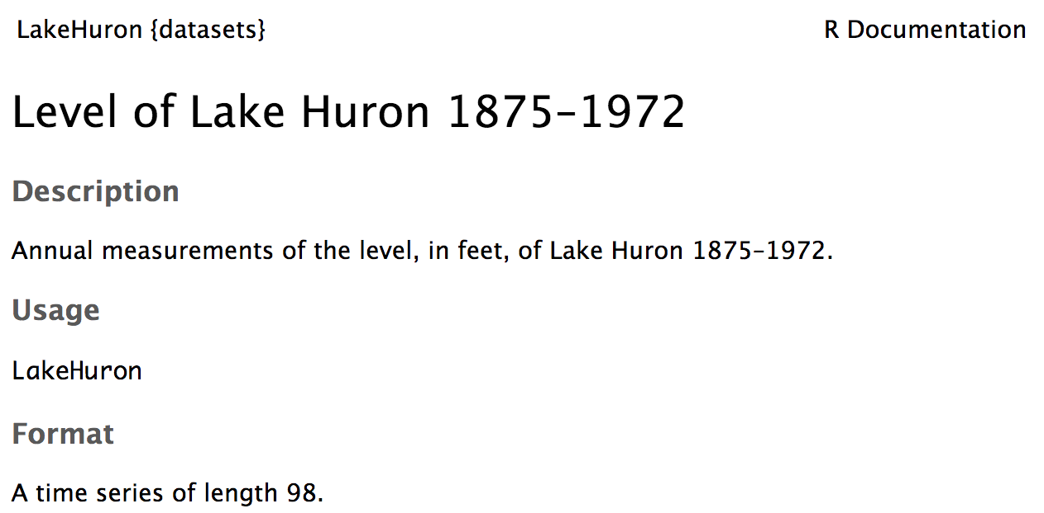
Break Out 5
Identify and estimate a model that will be useful in forecasting the next 10 annual measurements of the level of Lake Huron.

Slide 22
End Break Out 5

Slide 23
Lake Huron

Slide 24
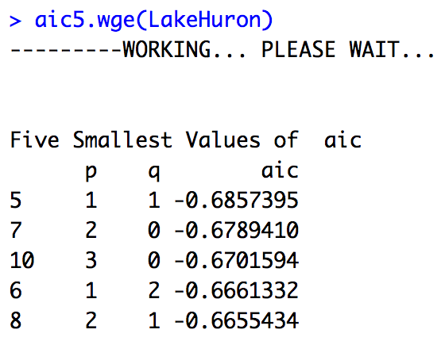
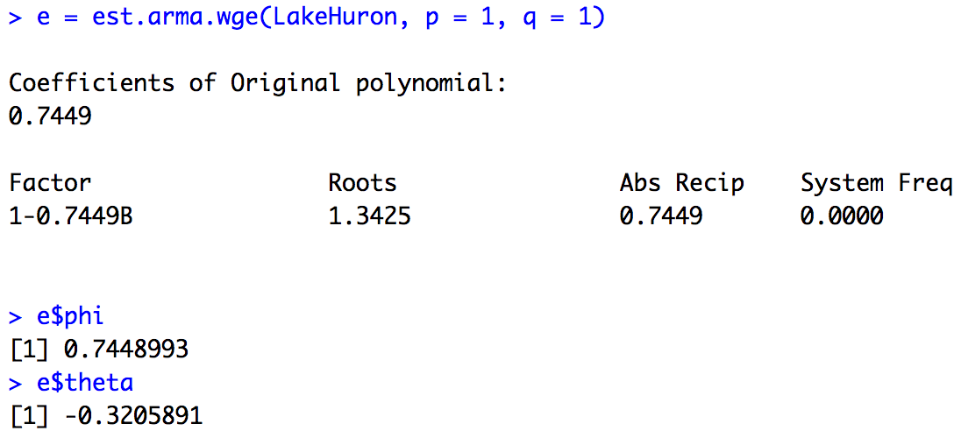
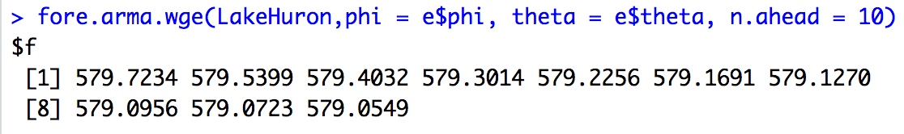
Lake Huron

